Slide 1
Grant Bourzikas Case Study 2
Doing Data Science MSDS 6306 – Fall 2018 Sadler

Slide 2
Building a Successful and Healthy Organization
What do we want to accomplish?
Desired Outcome
Understand Key Attrition Factors
Predicting Future Attritions
Leverage Data Science to enhance Business Process
How will we navigate the discussion?
Exploring Your Greatest Assets
Understand Why Attrition Occurs
Predicting Attrition in your Organization

Slide 3
Exploring Your Greatest Assets
Received 1470 Employee Records
Performed Analysis of Employee Features
Key to understand relationship between Employee and key decision features for attrition

Slide 4
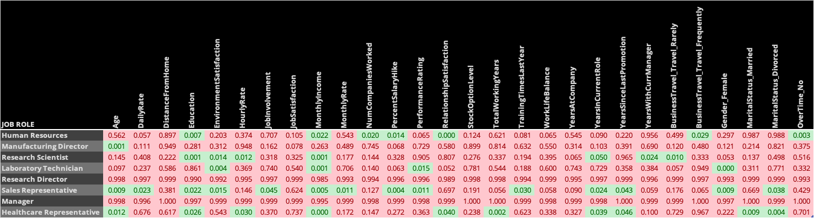
Understand Why Attrition Occurs
asdfasdfasdf

Slide 5
Predicting Attrition in your Organization
Nearest Neighbors
Accuracy : 84%
Sensitivity : 100%
Specificity : 2%
Nearest Neighbor Weighted
Accuracy : 84.3%
Sensitivity : 100%
Specificity : 4%
Logistic Regression
Accuracy : 87%
Sensitivity : 97%
Specificity : 35%
Logistic Regression with LASSO
Accuracy : 86%
Sensitivity : 97%
Specificity : 35%

Slide 6
Appendix

Slide 7
URL’s
YouTube Video
https://youtu.be/kGOE1Jl12PE
GitHub
https://github.com/gbourzikas/DDS6306/tree/master/Project2

